Slide 1


TRAFFIC MANAGEMENT SYSTEM
Team Members :
24KB1A0509
24KB1A0577
24KB1A05G1
24KB1a05Z1
24KB1A05Z2
24KB1A05D6
BRANCH & SECTION: CSE - J

Slide 2
Introduction:
Prioritizes VIP and emergency vehicles.
Manages signals at a four-way intersection.
Simulates real-time traffic flow based on vehicle type.
SOURCE CODE :
https://github.com/Narasimha5974/Data-Structures-and-Algorithms/blob/01f6ce97ea660c4634594f2d36775932c58ca7d1/TRAFFIC%20MANAGEMENT%20SYSTEM.c

Slide 3
Previous System:
Feature | Basic System | Priority-Based System
Signal Logic | Fixed time rotation for each direction | Dynamic signal based on vehicle priority
Vehicle Types Considered | No distinction (treats all vehicles equally) | Differentiates VIP, Ambulance, Two-Wheelers, Four-Wheelers
Priority Handling | None | Gives preference to emergency and VIP vehicles
Efficiency | Low during peak or emergency situations | High, as it adapts to real-time vehicle importance
Realism | Basic simulation | Closer to real-world intelligent traffic systems
Complexity | Simple logic and structure | Advanced logic with scoring and decision-making
Use Case | Learning signal timing and sequencing | Implementing smart traffic control for emergency responsiveness

Slide 4
Drawbacks of Previous Systems:
No Emergency Handling
Inefficient During Congestion
No Real-Time Adaptation
No Real Sensor Integration
Queue Starvation Risk

Slide 5
Objective :
Prioritize emergency and VIP vehicles
Use only C language and Data Structures (Arrays, Linked Lists, Trees)
Prioritize emergency and VIP vehicles

Slide 6
System Overview :
Simulates traffic signals at a four-way intersection.
Prioritizes emergency vehicles (ambulances) and VIP vehicles.
Regular vehicles (two-wheelers, four-wheelers) are given lower priority.
Uses a queue system to manage vehicles in each lane.

Slide 7
TECHNOLOGIES AND TOOLS :
File Handling for saving records
Enums – For defining vehicle types (e.g., VIP, Ambulance, Two-Wheeler, Four-Wheeler).
Control Structures:
If-else statements – For managing vehicle priorities.
Loops (for, while) – For simulating continuous vehicle processing and signal management.

Slide 8
WORKING FLOW :
Vehicle Arrival: Vehicles enter and queue by type.
Priority Determination: VIP and Ambulance vehicles are prioritized.
Signal Adjustment: Green signal is given to the highest priority lane.
Vehicle Passage: Vehicles pass through the intersection.
Signal Timing: Signal timing is adjusted for lower-priority lanes.
Queue Update: The queue is updated after vehicles pass.

Slide 9
MODULES IN PROJECT :
Vehicle Identification: Classifies vehicles by type.
Priority Calculation: Assigns priority based on vehicle type.
Signal Control: Controls signals for high-priority lanes.
Queue Management: Manages vehicle queues in lanes.
Signal Timing: Adjusts signal duration dynamically.

Slide 10
Advantages of Our System :
Efficient Traffic Flow
Real-Time Adaptation
Enhanced Safety
Optimized Resource Usage
Scalable

Slide 11
Challenges :
System Complexity: Managing dynamic priorities for multiple vehicle types.
Real-Time Data Processing: Handling traffic data in real-time can be resource-intensive..
Sensor and Hardware Limitations: Requires accurate vehicle detection and sensor integration.

Slide 12
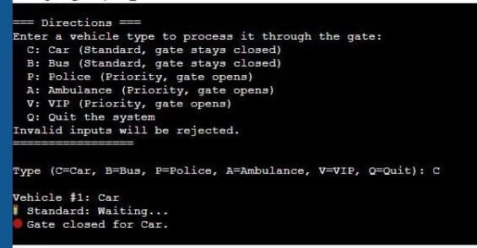
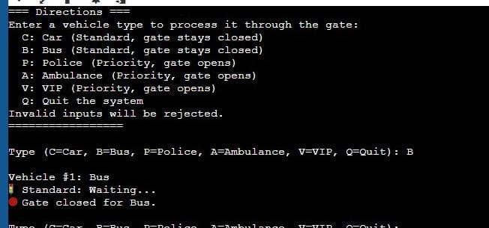
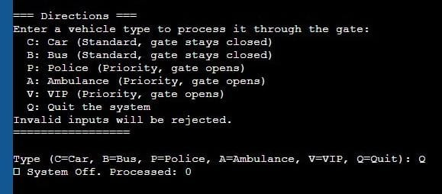
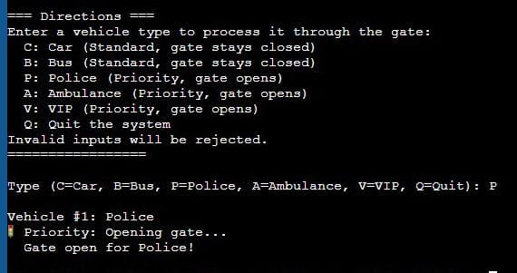
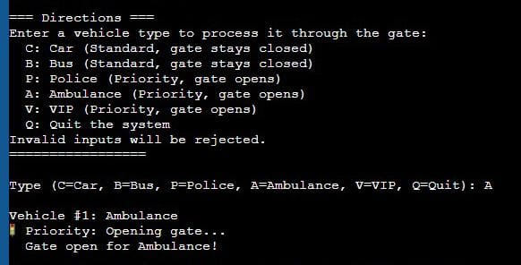
Output Images :

Slide 13
Conclusion :
The Traffic Management System improves efficiency by prioritizing emergency and VIP vehicles, ensuring smooth traffic flow. Though it faces challenges such as system complexity and scalability, its real-time adaptability and safety benefits make it a valuable tool for modern traffic management.

Slide 14
Thank You

